Slide 1

Docker Training
By Ionut Pac-Balaj

Slide 2
agenda
1
Docker Fundamentals
Analogies and hands on docker core commands
2
Docker Compose Fundamentals
We will explore the benefits of using docker-compose
3
Apply accumulated knowledge for AW setup
Based on what we learned so far, we will apply the knowledge on the AW setup.
4
Workshop on AW setup
If possible, we will do the complete AW setup. Help from the developers will be needed here

Slide 3

What are your expectations?
https://app.sli.do/event/eBr2QddM5fKAoJTfUv64Gw

Slide 4

What is a virtual Machine?
A virtual machine (VM) is a software emulation of a physical computer. It allows you to run multiple operating systems on a single physical machine, effectively partitioning the resources and isolating each virtual environment.
Great, now everything is clear !

Slide 5

Virtual machine - Analogy
An analogy for explaining virtual machines (VMs) is that of an apartment building. Imagine that the physical server is like a large apartment building. Each virtual machine running on that server is like an individual apartment within the building.
Just as each apartment has its own space, walls, utilities, and can be decorated according to the tenant's preference, each virtual machine operates independently within the physical server. They have their own operating system, applications, and resources, such as CPU, memory, and storage, that are allocated from the overall resources of the physical server.

Slide 6
Questions
Raise your hand or post a question in Slido
Notes:
Docker login -

Slide 7

Introduction to Docker
Docker is an open-source platform that uses containerization technology to develop, ship, and run applications
It allows applications to be packaged along with their dependencies into a standardized unit called a container, which is isolated and reproducible
Great, but what does that mean?

Slide 8
Docker - Analogy
Imagine the physical server is still the building, but this time, instead of each virtual machine being a separate apartment, Docker containers are like individual rooms rented out within a shared house
Each room (container) has its own space, with essential furniture and appliances (applications and dependencies) that it needs to function, but it shares common areas like the kitchen, living room, and bathroom (the underlying operating system and hardware resources) with other rooms.

Slide 9
Docker vs VMs - Analogy
Docker Containers are lightweight and need less space because they don’t each require their own full set of appliances; they share the major facilities.
Virtual Machines are like full apartments, having all facilities self-contained and not shared with others, which can be bulkier and more resource-intensive.

Slide 10
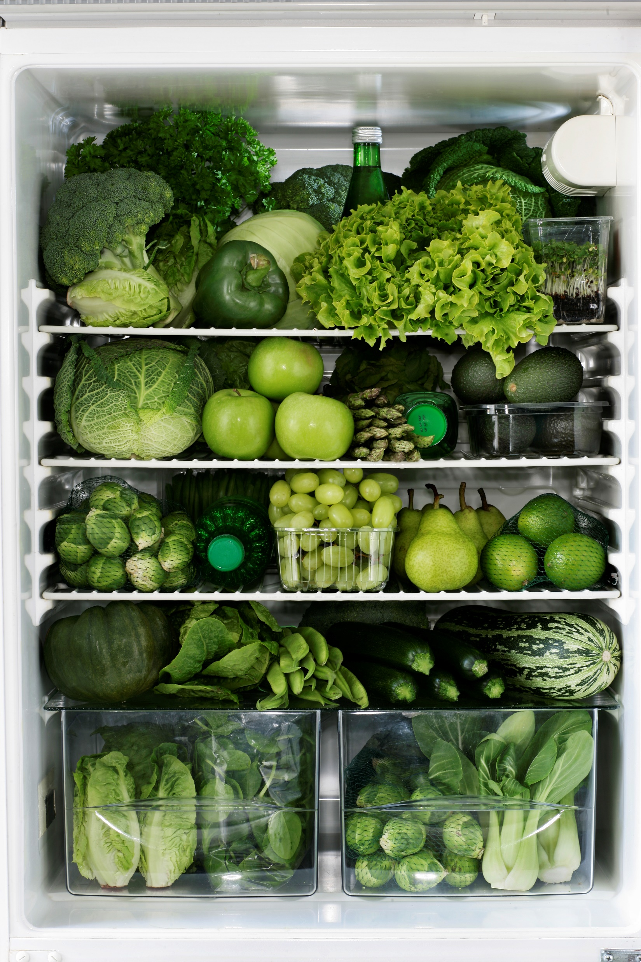



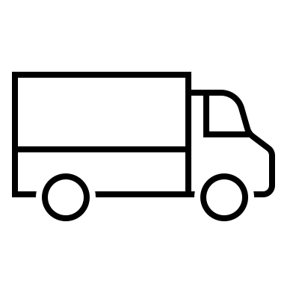

Docker architecture - Analogy
Fridge
Get ingredients
Order food
Ask the chef
Get ingredients from
external suppliers
Client
Chef
Suppliers
Waiter
Chef
Prepares food
Notes:
Frigider

Slide 11

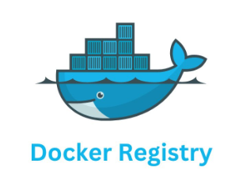

Docker architecture
Docker Host
Container Images
Docker client
Run commands
Stores images
Pull images
IT person
Creates Containers
Container instances

Slide 12
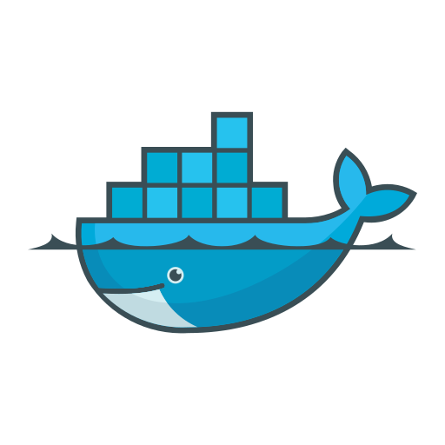

Prerequisites
Docker
https://www.docker.com/products/docker-desktop/
Visual Studio Code + Docker Extension
https://code.visualstudio.com/download

Slide 13
Install docker ( We ended up installing docker engine using AW powershell scripts)
Download docker
Install Docker ( check Appendix A)
Disable WSL
Sign up with docker hub. For our testing purposes we will use docker hub
You will get a WSL exception ( check Appendix A)
Switch to windows containers
Concept | Command
Docker download url | https://www.docker.com/products/docker-desktop/
Check docker version | docker --version

Slide 14
Example 1
Let's suppose we want to run an ASP NET CORE API and a NodeJS API on a Windows 11 machine?
Applications Technology stack:
ASP NET CORE 8 - .NET 8
NodeJS
Requirements:
Expose the ASP Net Core application on localhost port 8080
Expose the NodeJS application on localhost port 3000

Slide 15
Required steps to install the application without Docker
1
2
3
4
5
Define the list
of prerequisites
Download/Copy
prerequisites on
the target machine
Install all prerequisites
Install/Run the applications
Update
When a new version of the application is launched, you will have to install the update of the app along with the updates of all prerequisites if needed
The development team must provide the list of all prerequisites that are needed to successfully install the application
.NET 8 Runtime
NodeJS
.NET 8
https://dotnet.microsoft.com/en-us/download/dotnet/8.0
NodeJS
https://nodejs.org/en/download/current
Install the .NET 8 runtime
Install NodeJS
Restart the machine
Notes:
Continua analogia cu masina remote
Setup customer machine

Slide 16
Install the application with Docker
1
2
3
4
Install Docker
Pull the applications
docker image
Run the container
Update
Go to https://docs.docker.com/desktop/install/windows-install/
Pull docker images
Run the containers
Pull new image versions and run containers
Notes:
Show how the steps are simplified

Slide 17

Docker is magic
First, we will just execute the Docker Magic Commands and down the road we will dive into them.

Slide 18
Core Image commands
Concept | Command
Show all images | docker image ls
Pull image. Latest version | docker pull imagename
Pull Image. Specific version | docker pull imagename:version
Inspect an image | docker image inspect imagename
Pull dotnet API image | docker pull ipacbalaj/dockertraining-dotnetapi
Pull node API image

Slide 19
Core Container commands
Concept | Command
Show all running containers | docker container ls
Show all containers | docker container ls -a
Stop a container | docker stop yourcontainername | docker stop yourcontainerid
Restart a container | docker start yourcontainername
Start a container by providing a custom name | docker container run --name yourcontainername yourimagename
Start a container detached | docker container run -d -p 8080:8080 --name yourcontainername yourimagename
Delete a container | docker rm yourcontainername

Slide 20
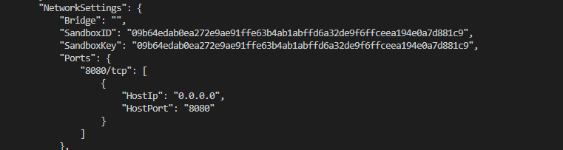
Why do we have to expose ports?
Start the application without exposing the port to the host machine.
Try accessing http://localhost:8080/swagger/index.html
Without mapping the container port to the host port the external clients cannot reach the containerized service via the host interface
Note: this is for the default networking type: to be discussed in the networking section
Inspect the container NetworkSettings area.
Run the container and map the container port to the host port
Inspect the container NetworkSettings area
Access http://localhost:8080/swagger/index.html
Concept | Command
Start container without exposing a port | docker container run --name yourcontainername yourimagename
Inspect the container | docker container inspect yourcontainername | yourcontainerid
Start container and expose the ports | docker container run -p 8080:8080 --name netapicontainername dotnetapi

Slide 21

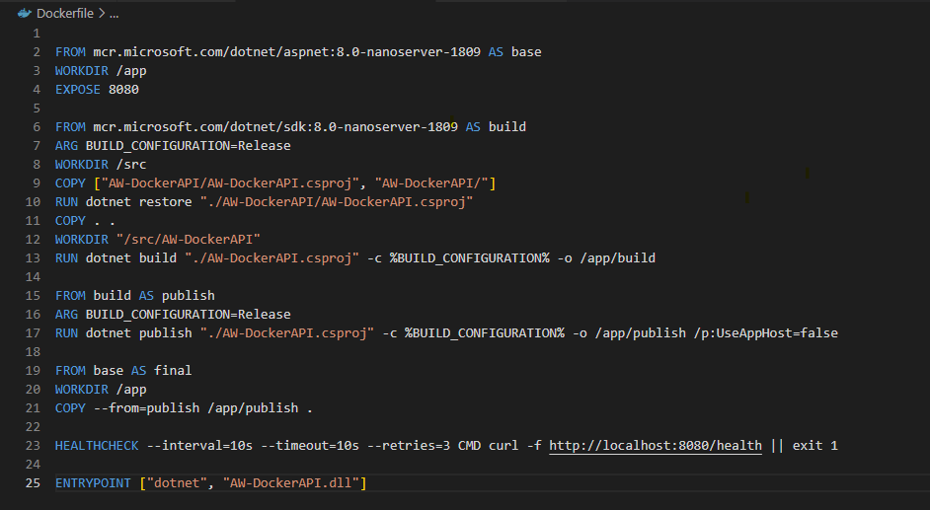
Health Check
How do we validate that the API is running correctly?
Docker has a HEALTHCHECK instruction that allows watching the current state of the container.
What if the port is not exposed? Is the container still showing as healthy?
Concept | Command
Check the health state of a container. The last state | docker inspect --format='{{json .State.Health}}' <container_id_or_name>
Show all containers. Check the status column | docker container ls
Healthcheck interval/retries and timeout are configured in the dockerfile | HEALTHCHECK --interval=10s --timeout=10s --retries=3 CMD curl -f http://localhost:8080/health || exit 1

Slide 22
Containers are ephemeral
Lets see what this means:
Start our dotnetapi container
Go to http://localhost:8080/swagger/index.html
Trigger the exception endpoint. This will write the exception in a log file on the disk
Check the log file in the container
Concept | Command
Start the container | docker container run -p 8080:8080 --name netapivolume dotnetapi
NodeAPI swagger url | http://localhost:8080/swagger/index.html
Stop the container | docker stop yourcontainername | docker stop yourcontainerid
Delete the container. You have to stop it first | docker rm yourcontainername | docker rm yourcontainerid
Run a container interactive | docker run -it yourcontainername cmd
Attach to a running container | docker exec -it <container_name_or_id> powershell docker exec -it <container_name_or_id> cmd
Navigate to logs folder. Execute in cmd | cd C:\app\logs
Print the contents of the log file. Execute in cmd | type logfilename.txt ( check your actual log file name)
Exit from container interactive session. Execute in cmd | exit

Slide 23
Containers are ephemeral
Stop the container
Restart the same container
Check the log file again. The log files are still there
Delete the container
Start a new container
Check the log files. They are gone
Concept | Command
Start the container | docker container run --name netapivolume nodeapi
NodeAPI swagger url | http://localhost:8080/swagger/index.html
Stop the container | docker stop yourcontainername | docker stop yourcontainerid
Start a stopped container | docker start yourcontainername
Delete the container. You have to stop it first | docker rm yourcontainername | docker rm yourcontainerid
Attach to a container | docker exec -it <container_name_or_id> cmd

Slide 24
Docker Volumes
How do we keep our data even if the container is gone?
We can bind the location in the container to a location on the host machine. This way each time data is saved from the container to that location it is actually saved at the location on the host machine
Run the container by mounting the logs location to the host location
Run the exception endpoint in the swagger page
Check the logs in the host machine folder
Delete the container. Logs are still at that location
Start a new container setting the same volume paths. The new container will have access to the old logs
Concept | Command
Mount the container path to a path on the host. | docker run -d -p 8080:8080 --name netapi -v c:\projects\AW\netapicontainerlogs:c:\app\logs dotnetapi
NodeAPI swagger url | http://localhost:8080/swagger/index.html
Delete container | docker stop yourcontainername | docker stop yourcontainerid
Start a stopped container | docker start yourcontainername
Delete the container. You have to stop it first | docker rm yourcontainername | docker rm yourcontainerid
Attach to a container | docker exec -it <container_name_or_id> cmd

Slide 25
How do we monitor container resources?
Start the dotnet api container
http://localhost:8080/swagger/index.html
Run docker stats
Trigger the CPUSpike endpoint.
The timeOfSpikeInSeconds property specifies how much time the CPU spike should last
Trigger the endpoint in parallel and check the CPU column
Trigger the MemorySpike endpoint
Trigger NET IO endpoint
Trigger BLOCK IO endpoint
Column Name | Command
CPU % | CPU percentage Used
PRIV WORKING SET | The RAM memory used
NET I/O | 1.03 MB / 1.82 MB indicates that the container has sent 1.03 MB of data and received 1.82MB since it started
BLOCK I/O – Monitoring IO ussage | 1.42 MB/33MB is the amount of data read from storage / amount of data writtern to the storage
Swagger page | http://localhost:8080/swagger/index.html
Notes:
Refferemce : https://docs.docker.com/reference/cli/docker/container/stats/
1MB / 1.79MB indicates that the container has sent 1MB of data and received 1.79MB since it started

Slide 26
Environment variables
What if we want to customize certain variables from our application ?
How do we modify them at the container level?
Run container with Environment variables set
Go to dot net api swagger page
Trigger api/EnvironmentVariables/EnvironmentVariable endpoint
Check the response.
Check with docker inspect
Concept | Command
Run container by passing environment variables | docker run -d -p 8080:8080 -e ASPNETCORE_ENVIRONMENT=Production -e CUSTOM_ENV=Our_Custom_value dotnetapi
Swagger Page | http://localhost:8080/swagger/index.html

Slide 27
Logs
Checking the container logs is essential in monitoring your application’s behaviour:
Debug your application
Monitor your container activity
Troubleshoot
Audit and Compliance
Concept | Command
Show logs | docker logs yourcontainername | yourontainerId
Continuously monitor the logs | docker logs -f yourcontainername | yourontainerId
Show logs with timestamps | docker logs -t yourcontainername | yourontainerId
Show only the latest logs | docker logs –-tail 100 yourcontainername | yourontainerId

Slide 28
AW Cantor Setup
Notes:
Docker login -

Slide 29
Agenda session 2
1
Install all prerequisites
We will run the scripts to install everything is needed for the full setup
2
Switch to a hands-on session
We will trigger a docker pull and in the meantime, we will switch to a hands-on session
3
Switch Back to AW installation
Based on what we learned so far, we will apply the knowledge on the AW setup.

Slide 30

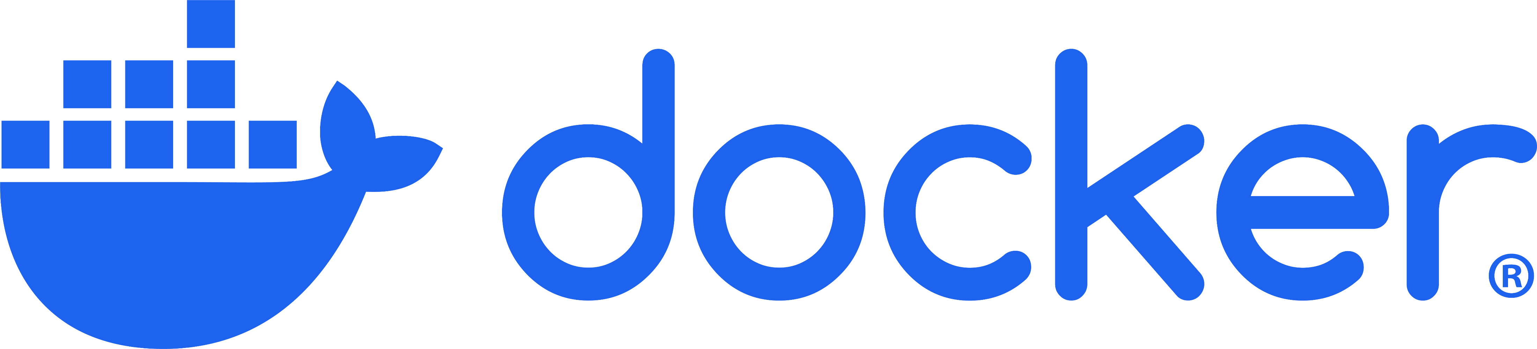
Playground – Hands On Session
Azure Container Registry
Your Personal Machine / Server
DOTNET API
Images
Containers
DOTNET API
DOTNET API
Docker Container
Docker Image
Notes:
Will you use it?

Slide 31
Run docker compose
Run docker compose
Check all the configurations : volumes, ports, environment variables
Concept | Command
Start both containers using docker compose | docker-compose -up
Stop both containers using docker compose | docker-compose down
List the running containers | docker container ls
Inspect the containers | docker container inspect yourcontainername|yourcontainerId
Node API | http://localhost:3000
Dotnet API | http://localhost:8080/swagger/index.html
Notes:
The conductor doesn't play an instrument but ensures that all parts of the orchestra work together harmoniously and that the music flows seamlessly. Similarly, Docker Compose doesn't run services itself but makes sure all services (containers) start up in the correct order and operate together smoothly.

Slide 32
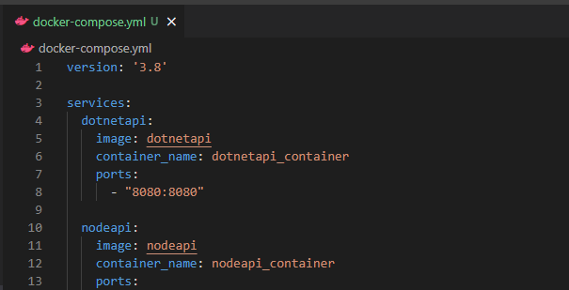
How can we group together all configurations? Docker Compose
What can we use to run both APIs at the same time with a single command?
Let's starts with the simplest compose file that allows us to start our APIs with a single command and link their ports to our host ports
Check if the containers are running
Stop both containers. This will stop and delete both containers
Concept | Command
Start both containers using docker compose | docker-compose -up
Stop both containers using docker compose | docker-compose down
List the running containers | docker container ls
Swagger page .NET API | http://localhost:8080/swagger/index.html
Node API | http://localhost:3000

Slide 33
Agenda – session 3
1
Trigger docker pull for AW images
This will take a while. So we will get back to it later
2
Docker compose hands on session
3
Finish AW setup
We will finish the AW setup

Slide 34

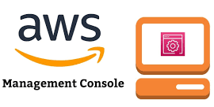
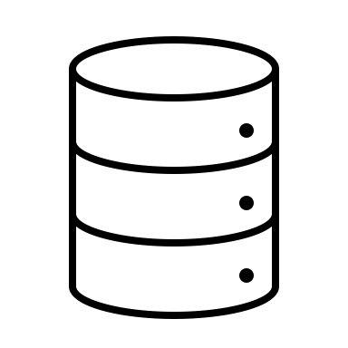
End goal for today
AWS container registry
API
In order to pull images you will have to be authenticated to the registry
C++ Worker
Your Personal Machine / Server
Message Bus
Images
Containers
API
API
C++ Worker
C++ Worker
Message Bus
Message Bus
Database Server
Visual Studio Code
Docker Container
Docker Image
Notes:
Will you use it?

Slide 35


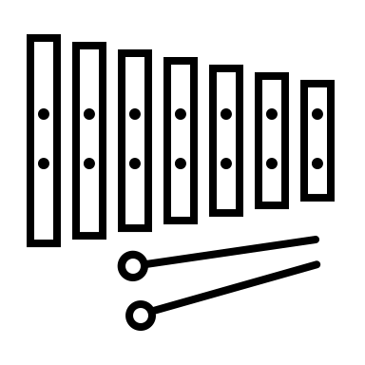




Docker compose – Analogy Orchestra
Notes:
What are the key things about an orchestra?
Why do you think is it similar to docker compose?

Slide 36
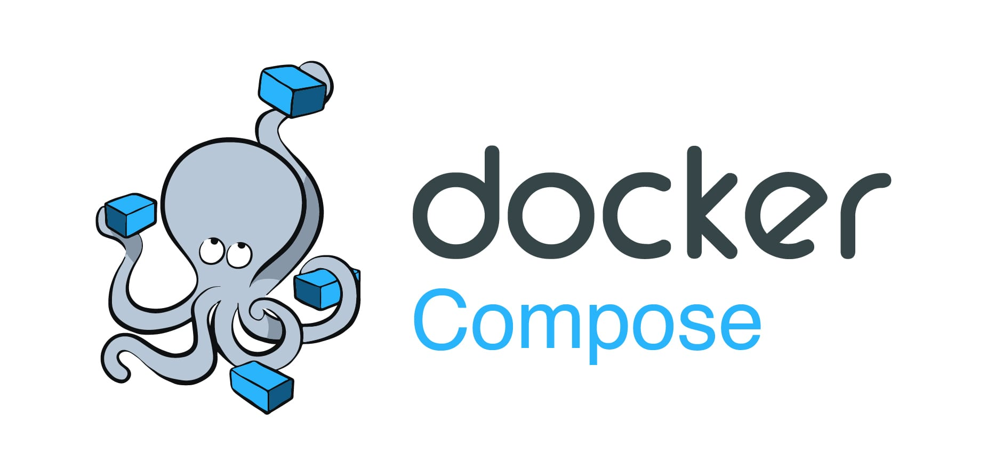


Docker compose – Restart Policy
Without a restart policy a manual intervention is needed
DOTNET API
What if the service goes down?
NODE API
What happens if our application fails?
How can we make sure it is restarted?
Restart options:
NO: this is the default and it will not restart automatically the container
On-failure: max-retries: just retries if it exists due to an error
Always: it always restarts unless manually stopped. It will restart when the docker deamon is restared
Unless-stopped: same as always, but it is not restarted when the docker deamon is restarted

Slide 37
Docker compose – Network
Network: aw-dockertraining-api_docker-training-network
Network: aw-dockertraining-api second-network
DOTNET API
172.26.180.161/16
Container A
172.77.180.1/16
They can communicate using IP or their Service name
They can communicate using IP or their Service name
NODE API
172.26.179.206/16
Container B
172.77.179.2/16
We will just discuss NAT networks
NAT networks have the following key features
ISOLATION – containers are isolated from the host and other containers by default
PORT Mapping – allows mapping of host ports to container ports
IP Address Management – Docker assigns IP addresses to each container in the network. Allows communication between containers in the same network
DNS Resolution – Provides built-in DNS resolution, allowing containers to communicate using container names
Notes:
Use the same host ports to see what happens .

Slide 38
Installing new Versions
How can we install a new version of our application ?
How do docker images work?
Layer 3
Application Files
Application Files
Layer 2
ASP NET Runtime
ASP NET Runtime
Layer 1
mcr.microsoft.com/windows/servercore
mcr.microsoft.com/windows/servercore

Slide 39
Docker – Depends on and condition
DOTNET API
What if we need to wait for the NodeAPI to start before starting the Dotnet API?
NODE API
In an application with multiple services, there will be a need to coordinate the startup of those services.
What if a specific condition needs to be met

Slide 40

Docker compose – Network
DOTNET API
NODE API
What if the Physical Machine Gets restarted ?
What if we want to upgrade to a new version? What will happen?

Slide 41

Docker compose – Environment Files
DOTNET API
NODE API
If there is a default .env file at the same level with the docker compose file it will be loaded automatically
The environment files specified in the docker compose take precedence

Slide 42
Agenda – session 4
1
Finish AW Setup
Now that we have all the images pulled from AWS registry. We will go through the configuration steps to run the services locally
2
Troubleshooting
We will go through a list of scenarios in which the applications are not configured correctly and show how to troubleshoot the Issues

Slide 43
Overall picture
Server
Containers
API
C++ Worker
Event Store DB
Database Server
Docker Container
Docker Image

Slide 44

1. Troubleshoot – API connection to Database
Containers
API
C++ Worker
Event Store DB
Database Server
Resolution:
Look at API health-check
Attach to the API container and show logs

Slide 45
2. Troubleshoot – C++ connection to Database
Containers
API
C++ Worker
Event Store DB
Database Server

Slide 46
2. Troubleshoot – C++ connection to Database – C++ worker explained
Global Config allowing enabling /disabling processes
C++ Worker
Authentication Stream
Back Order Creation Stream
BOM Stream
Recommendation: Just enable the authentication stream to only generate logs for the authentication and then check the logs file

Slide 47
3. API cannot connect to Event Store DB
Containers
API
C++ Worker
Event Store DB
Database Server
Resolution:
Look at API health-check
Attach to the API container and show logs

Slide 48
4. C++ worker cannot connect to Event Store DB
Containers
API
C++ Worker
Event Store DB
Database Server
Resolution:
Check traces
Suggestion: Just enable the authentication stream in the C++ worker (Troubleshoot – C++ connection to Database – C++ worker explained)

Slide 49

5. Certificate mismatch or misconfigured
Containers
API
C++ Worker
Event Store DB
Database Server
Resolution:
Make sure same certificate is set for both API and C++ worker
Make sure a password is set correctly

Slide 50
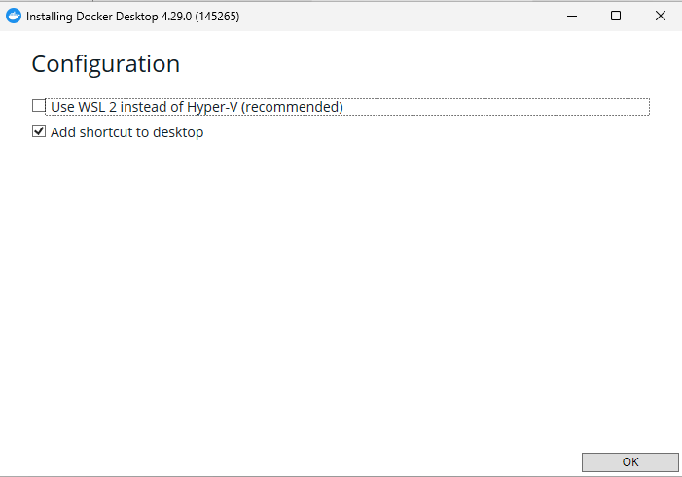
Appendix A – Install Docker – Disable WSL

Slide 51
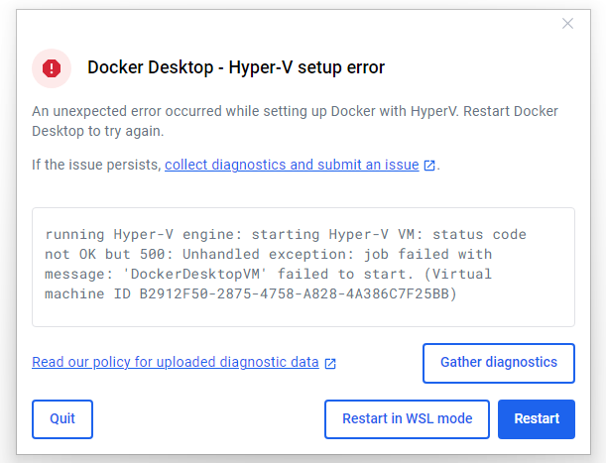
Appendix A – Install Docker - WSL exception

Slide 52
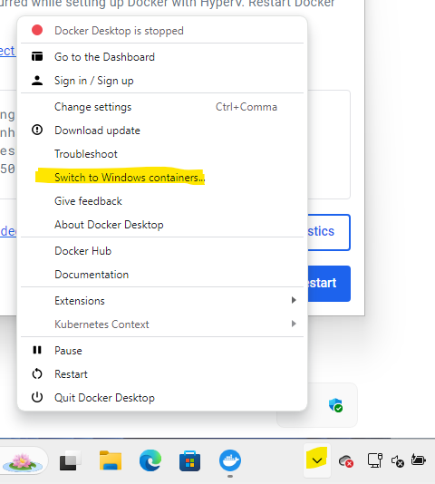
Appendix A – Install Docker - Switch to windows containers

